Slide 1
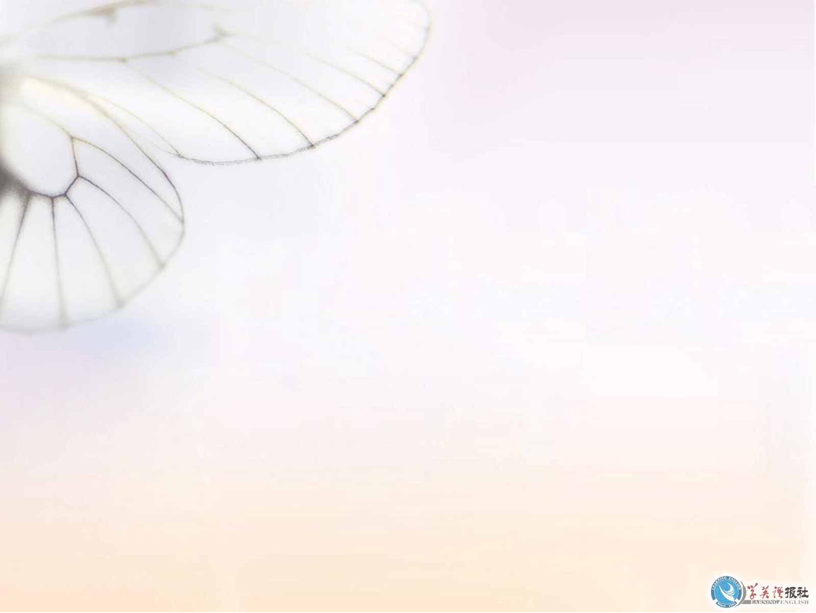

Unit 3
Foreign Food

Slide 2
Introduction
Can we go without food?
Can you name some Chinese food as well as some foreign food?

Slide 3
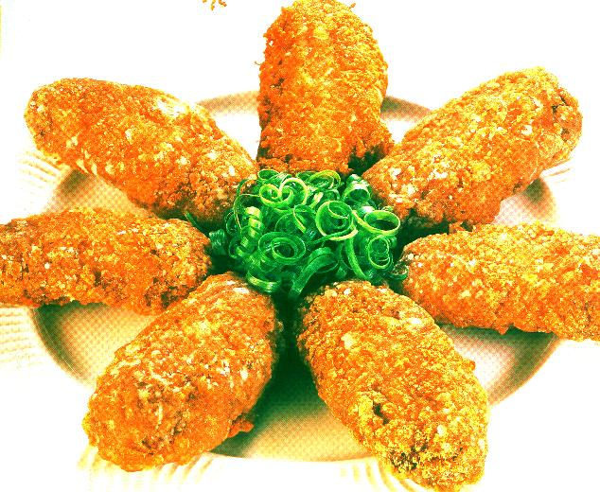
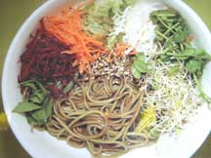
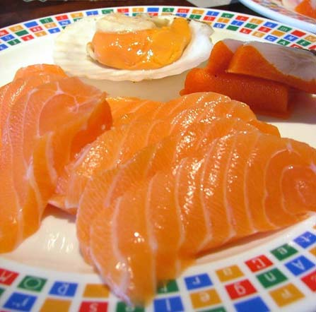
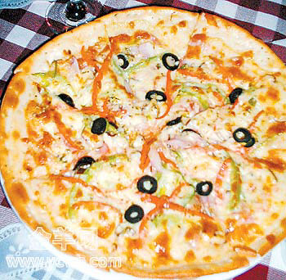
Fried chicken
salad
raw fish
pizza

Slide 4
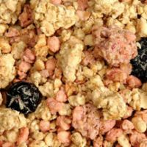
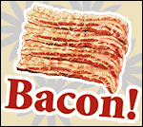
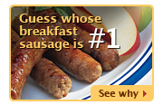
British food
cereal
bacon
sausage

Slide 5
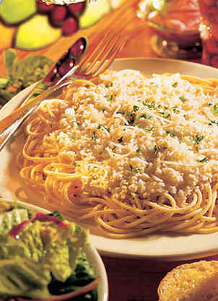
Italian food
Spaghetti

Slide 6
Quotations
Everything you see I owe to spaghetti.
Sophia Loren, Italian actress
Meaning: 我非常喜欢吃意大利面。
Eat little, sleep well.
Iranian proverb
Meaning: 吃的少, 睡的好。

Slide 7
What is food to one man may be poison to another.
Lucretius, philosopher in Classical Rome
Meaning: 一个人的食物可能是另一个人的毒药。
Cookery is not chemistry. It is an art.
Marcel Boulestin, French television cook
Meaning: 烹调并不是化学实验 , 烹调是艺术。

Slide 8
If you’re going to America, bring your own food.
Fran Lebowitz, American writer
Meaning: 如果你去美国,请自备食物。
You should eat to live, not live to eat.
Socrates, Greek philosopher
Meaning: 吃饭是为更好的生活,但不能只是为了吃饭而活着。

Slide 9
Activities
Find some similar Chinese quotations.
冬吃萝卜夏吃姜，不用大夫开药方。
若要小儿安，三分饥三分寒。

Slide 10
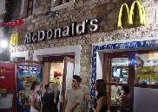
Q&A
1.What are the two biggest fast food restaurants?
KFC and McDonald’s
Fried chicken
Milk shake
Ice cream
Coca Cola
Hamburgers
French fries
Pie
…
2.What kind food are sold In KFC or McDonald’s?

Slide 11
Reading and Vocabulary
taste
obsess
banquet
dish
greedily
chopstick
n.味道
v.使着迷
n.宴会
n.一道菜
adv.贪婪地
n.(常复)筷子
Words and Expressions

Slide 12
dessert
no wonder
intestine
tongue
hoof
end up
n.甜食
难怪
n. (常复)肠
n.舌头
n.(猪、牛等的)蹄
结束

Slide 13
chew
delicacy
infamous
appetising
manner
make out
requirement
v.咀嚼
n.佳肴，珍馐
adj.声名狼藉的
adj.开胃的
n.方式，方法
看出，理解
n.要求

Slide 14
tuna
fixed
mushroom
mash
filling
unrecognisable
have…in common
n.金枪鱼
adj.固定的
n.蘑菇
v.捣烂，捣成烂泥
n.馅
adj.无法辨认的
与……有共同点

Slide 15
Pre-reading
a. If an American eats Chinese food in China, what will he notice?
b. If a Chinese eat British food for the first time, what will he notice?
1) the quantity of the food
2) what people do while they are eating
3) the taste of the food
4) the temperature
5) the strange things people eat

Slide 16
a. An American eating Chinese food in China will notice the quantity of the food/ the strange things people eat.
b. A Chinese eating British food will notice the temperature of the food/what people do while they are eating.

Slide 17
Passage 1
Check the true statements according to the text.
The writer thinks that Chinese people sometimes think too much about food.
( )
2) When the first six or seven dishes came to the table the writer started eating greedily because he had a very good appetite and could not wait for the rest of the dishes. ( )
T
F

Slide 18
3) Many westerners cannot understand why Chinese people eat almost part of an animal. ( )
4)When the writer asked the seller at the meat counter if they sold pig ears, the guy didn't really understand what he wanted.
( )
5)The writer hasn’t got used to all the Chinese food yet. ( )
T
T
T

Slide 19
2. Choose the best answer according to the passage.
1)It seems that the writer ____________.
A. had good opinion of Chinese food.
B. thought little of Chinese food
C. thought badly of Chinese food
D. thought Chinese people wastes a lot of food.
√

Slide 20
2) Which of the following is not related to the writer’s attitude?
A. Chinese people are sometimes obsessed with food.
B. I could not imagine how fabulous a real Chinese banquet continued.
C. These days I enjoy that sort of food himself.
D. I was already so full that I could only watch as the banquet could be.
√

Slide 21
1) By telling about his experience at the banquet, the writer wanted to _____.
A. tell people that Chinese people pay great attention to food.
B. say he was not experienced at a Chinese banquet.
C. tell people too much food was served at a Chinese banquet.
D. tell people to eat little first at a Chinese banquet.
√

Slide 22
2) By saying “Another aspect of ‘food culture’ is that the Chinese seem to eat almost every part of every animal –much to the horror of many westerners’’, the writer_____
A. wants to give information about Chinese food culture
B. wants to say Chinese food culture is horrible to westerners.
C. shows Chinese food culture is fabulous
D. shows every nation has its own food culture.
√

Slide 23
Activities
6
1.What mistake did the writer make at the Chinese Banquet?
He thought the first course was the whole meal and ate too much.
2.What impressed the writer at the banquet?
The quantity of food served.
3.What did the writer find shocking at first but then got used to eating?
Choudoufu.

Slide 24
Passage 2
1) It is not formal for people to eat in a sofa. ( )
2) The writer considered it hard to find out what the food boxes contained at the food counter. ( )
T
T

Slide 25
3) After the writer ate her first English food, she felt cold inside. ( )
4) English people like to mix food before serving it to the table, as is also the case with Chinese people. ( )
5) The writer thinks it hard to remember the names of English dishes. ( )
T
F
T

Slide 26
Choose the best answer according to the passage.
1) From the passage, we mainly learn ______.
A. about her experiences in England.
B. some of the differences between Chinese food and English food.
C. English people have good table manners.
D. English food.
√

Slide 27
2) What does the writer think of English food and Chinese food?
A. Chinese food is prepared with more care at the appearance.
B. English food is prepared very carelessly.
C. Cold food is liked by English people.
D. Mixed food is served at the table.
√

Slide 28
3) The writer _______ the mushroom soup to be married with other things.
A. could not get used to
B. felt it hard to know.
C. didn't expect
D. thought it funny for.
√

Slide 29
4) The purpose of the writer is ______.
A. to tell about English food culture.
B. to show her positive attitude towards English
C. to show her negative attitude towards English.
D. to tell what she thinks about English food.
√

Slide 30
Activities
6
4. What does the writer say about the appearance of food?
It was colourful.
5. What does the writer think about eating cold food?
It made her feel cold inside.
6. What does the writer think about the way British people eat?
It was very polite.

Slide 31
1 The writer of passage 1 _____.
A. doesn’t like Chinese food
B. hasn’t got used to most Chinese food yet
C. likes most Chinese food
3
√

Slide 32
2 The writer of passage 2 ________.
A. doesn’t like British food.
B. doesn’t like the way British food is prepared and served.
C. doesn’t like the way the British eat.
√

Slide 33
4
Passage 1
1. obsess
2. banquet
3. appetising
4. appetite
(e) to think too much about something
(c) a very large meal for a lot of people
(d) looking and smelling nice to eat
(a) the feeling of wanting to eat

Slide 34
5. dessert
6. fabulous
7. fellow guests
8. greedy
(f) a dish of sweet food
(h) wonderful
(b) other people at a party or dinner with you
(g) wanting to eat more than you need

Slide 35
Passage 2
1. make out
2. leftovers
3. mash
4. admire
(g) to see or understand what something is.
(e) food left from an earlier meal
(h) to press into small pieces
(a) to respect and approve of something or someone

Slide 36
5. requirement
6. manner
7. unrecognisable
8. filling
(f) something that someone needs
(d) the way something happens
(c) not easy to recognize
(b) food put inside sandwiches, cakes, etc.

Slide 37
5
Passage 1 | Passage 2
tasted: They just tried a little of each dish. | taste: What flavour did it have in the person’s mouth
serve: brought to the table by the waiters | prepared: got ready before eating.

Slide 38
Organization
Passage 1
Part | Para | Main idea | Thread
1 | 1-2 | ＿＿＿＿＿＿＿＿＿＿＿＿＿＿＿＿＿＿ is part of Chinese food culture, which is concluded by a foreigner after his __________ eating at a banquet in Beijing. | shocked
That Chinese are obsessed with food
experience

Slide 39
Organization
Passage 1
Part | Para | Main idea | Thread
2 | 3-5 | Chinese’s food includes __________ animals’ parts, which the foreigner found ______ to accept at the beginning, but later, became ___________ | scared;
a variety of
became
fond of;
hopeful
hard
fond of.

Slide 40
Passage 2
Organization
Para. | topics | Main idea | Thread
1 |  | The writer likes the British people’s _____________ but ________________
amazed
confused
dislike
table manners
cold food
table manners
not their cold food.

Slide 41
Passage 2
Organization
Para. | topics | Main idea | Thread
2 |  | The absence of ___________ _____________ makes the food look not so ______ as it should be.
3 |  | the names of the English food are hard to remember
beauty and
style of
the food
astonished
beauty and
style of food
tasty
names of
the food
find it
hard
admire

Slide 42
Key Words
Stomach, intestines, ears, tongue, tail, hoof, and lungs are all likely to end up on the dinner table in front of you. 胃、肠、耳朵、舌头、尾巴、蹄子以及肺，最终都有可能出现在你面前的餐桌上。
在这个句子中，end up 表示“最终、结果”的意思，通常与with 连用表示“以……结束”。

Slide 43
e.g. We worked hard for the boss throughout the year around while ended up with empty hands. 我们为这个老板全年辛勤工作，到头来两手空空。
end up 后面也可以接动名词，表示“最终、结果做某事”。
e.g. Tom and John quarreled the whole morning about where to go, yet they ended up staying at home. Tom和John为去哪里争论了一上午，结果还是呆在了家里。

Slide 44

wind (wound) up与end up 的意思接近， wind up 往往表示结果不如人意。
e.g. Even after going through this analysis, you may wind up with no clear-cut answer.
即使你仔细地进行了分析，最终你仍可能得不到清晰的答案。

Slide 45
2. Do their ideas have anything in common? 他们的想法之间有什么共同的东西吗？
in common 表示“共同、共同享有的”。
common的类似用法如：have nothing in common (with) 表示 “(与……) 没有共同之处”。

Slide 46
e.g. What you have suggested has nothing in common with my proposal.
你的建议与我的提案之间没有丝毫共同之处。
out of common 表示“特殊的、不同寻常的”。
e.g. This kind of signs are totally out of common.
这些迹象太不同寻常了。

Slide 47
3. It was quite hard to make out what they contained. 很难辨认出它到底包含了什么。
在这个句子中，make out 表示“辨认出”，同时还有“开出、把……说成、证明”等意思。
e.g. I came over to him and made out a check immediately.
我走向他，并且立刻开出了一张支票。

Slide 48
Surprisingly, he made out he was the first scientist to discover the truth.
真是奇怪，他居然声称他是第一个发现这个原理的科学家。
You are not such an evil guy that everyone makes out.
你并不是大家所说的那样的坏蛋。

Slide 49
4. No wonder my fellow guests had had only a few bites of each dish, they knew what was still to come. 难怪我的朋友们仅吃了一点点，他们知道还有菜没有送上来。
在这个句子中，no wonder表示“难怪、不足为奇”，类似的用法如：for a wonder 表示“意想不到地”。

Slide 50
e.g. He survived this serious car accident for a wonder.
他能从这样严重的车祸中逃生真是意想不到。
it is a wonder that “奇怪的是……”。
e.g. It was a wonder that this leading team lost this game.
很奇怪这只排名领先的队输掉了这场比赛。

